Slide 1
Nearest Neighbour Classifier

Slide 2
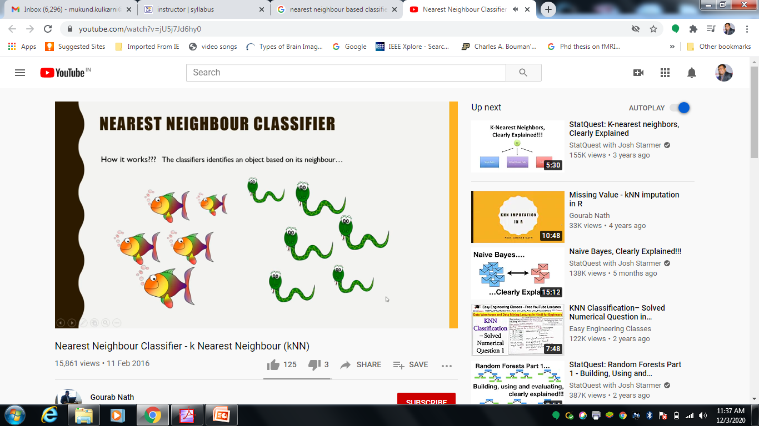
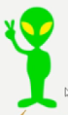
Nearest Neighbour Classifier
How it works?
The classifier identifies an object based on its neighbour
Who
am I?

Slide 3
How it works?
Only 1 Neighbour
2 Neighbours
3 Neighbours
Who
am I?

Slide 4
What Is KNN Algorithm?
KNN which stand for K Nearest Neighbor is a Supervised Machine Learning algorithm that classifies a new data point into the target class, depending on the features of its neighboring data points.

Slide 5
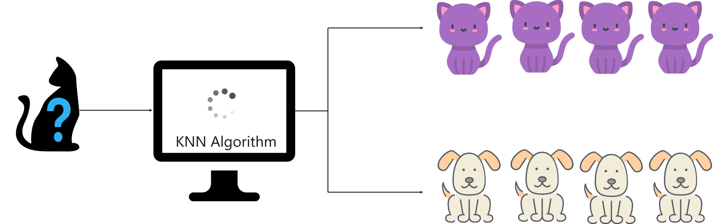
Let’s try to understand the KNN algorithm with a simple example. Let’s say we want a machine to distinguish between images of cats & dogs. To do this we must input a dataset of cat and dog images and we have to train our model to detect the animals based on certain features. For example, features such as pointy ears can be used to identify cats and similarly we can identify dogs based on their long ears.

Slide 6
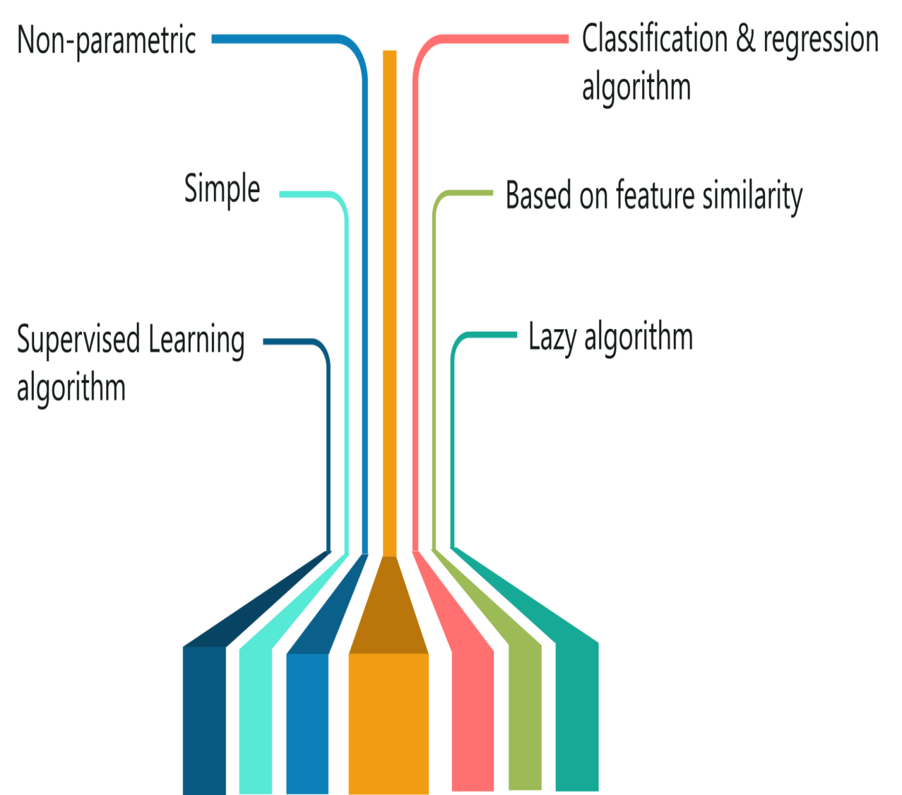
Features Of KNN Algorithm
The KNN algorithm has the following features:
KNN is a Supervised Learning algorithm that uses labeled input data set to predict the output of the data points.
It is one of the most simple Machine learning algorithms and it can be easily implemented for a varied set of problems.
It is mainly based on feature similarity. KNN checks how similar a data point is to its neighbor and classifies the data point into the class it is most similar to.

Slide 7
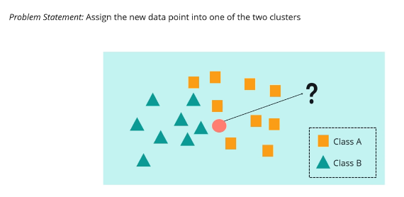

Slide 8


Slide 9
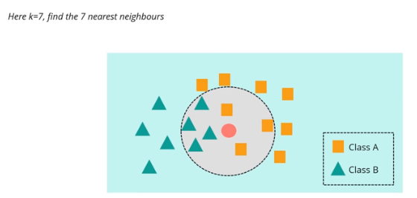

Slide 10
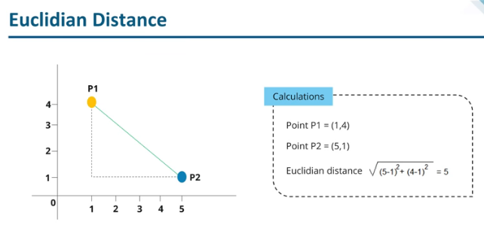
Manhattan distance
Cosine similarities

Slide 11
Height(Feet) | Weight(Pounds) | Obesity
5.33 | 182 | Obese
5.17 | 190 | Obese
6.5 | 193 | Overweight
5.67 | 210 | Obese
6.17 | 225 | Overweight
5.58 | 168 | Overweight
5.75 | 215 | Obese
6.25 | 249 | Obese
6.08 | 210 | Overweight
5.25 | 163 | Overweight
5.42 | 175 | Overweight
5.67 | 200 | Obese
In multivariate analysis, each example is represented as a data point in a d dimensional space, where d is the no. of attributes
So each of these observation – the obesity and overweight status can be represented as a point in 2 dimensional space
6 Obese
and
6 Overweight
5.95 | 210 | ?

Slide 12
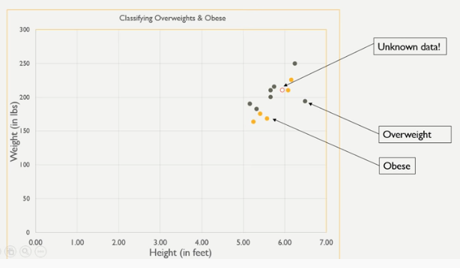
Let us look at this data visually
Height(Feet) | Weight(Pounds) | Obesity
5.33 | 182 | Obese
5.17 | 190 | Obese
6.5 | 193 | Overweight
5.67 | 210 | Obese
6.17 | 225 | Overweight
5.58 | 168 | Overweight
5.75 | 215 | Obese
6.25 | 249 | Obese
6.08 | 210 | Overweight
5.25 | 163 | Overweight
5.42 | 175 | Overweight
5.67 | 200 | Obese
5.95 | 210 | ?

Slide 14
2 Nearest Neighbour
1 obese
1 overweight

Slide 15
3 And 4 Nearest Neighbour
2 overweight
1 obese
3 overweight
1 obese

Slide 16
K-NN Algorithm
K – NN Algorithm can be summarized as:
A positive integer k is specified, along with a new sample
We select k entries in our data set which are closest to the sample
We find most common classification of these entries
finally, this is the classification we give to the new sample

Slide 17
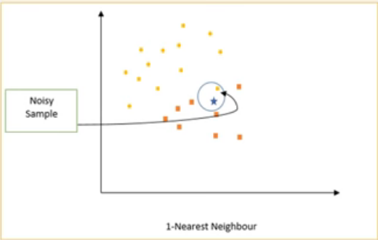
How to choose K?
If k is too small, then the nearest neighbour classifier may be susceptible to overfitting because of the noise in the data

Slide 18
How to choose K?
On the other hand If k is too large, then the nearest neighbour classifier may mis-classify the test instance because its list of nearest neighbour may include data points that are located far away
Usually the value between 5 to 10
Is taken as a reasonable value of k

Slide 19

K NN Use case - recommendation engines

Slide 20
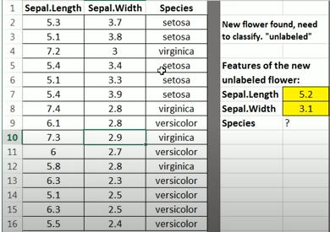

Slide 21
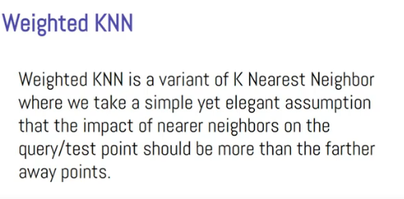

Slide 22
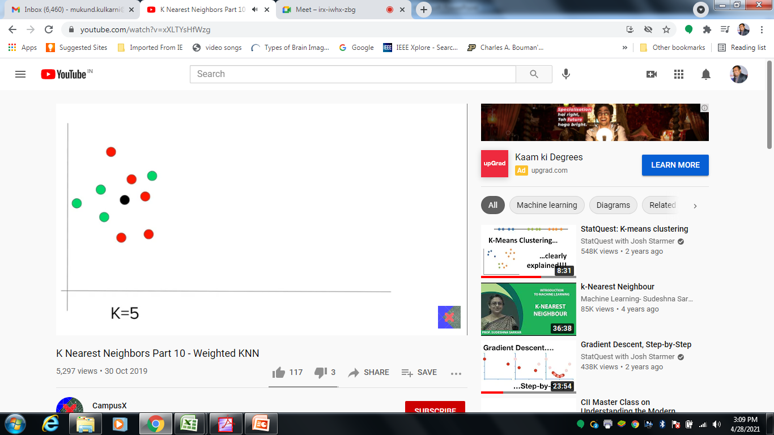

Slide 23
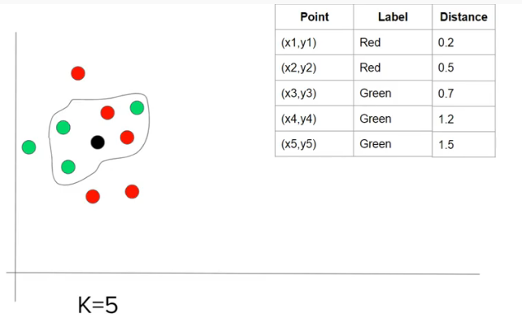

Slide 24
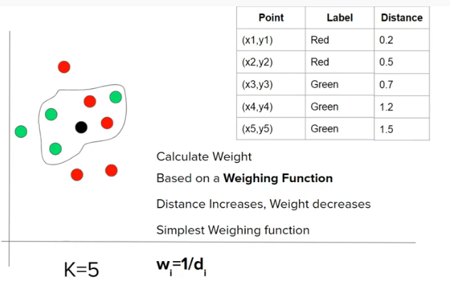

Slide 25


Slide 26
